Slide 1
Solutions Tasks 11-15
Manfred Zinn
ChE-437

Slide 2
Task 11: Steady-state concentration in a chemostat
Zymomonas mobilis is used for a chemostat culture in a 60 m³
fermenter. The feed contains 12 g L⁻¹ glucose; Ks for the organism is
0.2 gL⁻¹.
What flow rate is required for a steady-state substrate concentration
of 1.5 g L⁻¹?
At the flow rate of (a), what is the cell density?
At the flow rate of (a), what concentration of ethanol is produced?
Following is known:
Y_{X/S} = 0.06 g g⁻¹; Y_{P/X} = 7.7 g g⁻¹; μ_{max} = 0.3 h⁻¹; K_{s} = 0.2 g L⁻¹;
s₀ = 12 g L⁻¹; V = 60 m³
D = 0.265 h⁻¹ F=15.88 m³ h⁻¹
x = 0.63 g L⁻¹
c = 4.851 g L⁻¹

Slide 3
Task 12: Application of chemostat
A bacterium is used to absorb (uptake) uranium from contaminated water in a continuous process operated at steady state. It incorporated uranium into cell mass, which is then removed from the bioreactor as solid waste. The advantage of the process is in converting a diluted contaminated water into a solid form for easier disposable.
Methanol is added to the feed water stream at a concentration of 5 g/l, which also contains 10 mg/l of uranium. The biomass yield on methanol is 0.6 g dry mass/g methanol. The Ks for methanol is 0.1 g/l, while the maximum specific growth rate is 0.345 hr⁻¹. The absorption of uranium follows zero order kinetics with respect to uranium concentration. The absorption kinetics can thus be described as R=-kx
Where R is the absorption rate and x is the cell concentration. Because of the environmental concern the discharge methanol concentration has to be no higher than 0.05 g/l, while the target uranium concentration at discharge is 0.5 mg/l. It has been assumed that about 0.5 g uranium can be bound by one gram biomass.
What is the value of the reaction rate constant for absorption that will allow the uranium to be discharged in a continuous culture?
As it turns out, the absorption rate constant is only half of the needed to accomplish the decontamination process. What will you do to meet the discharge regulation?

Slide 4
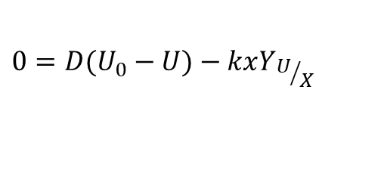
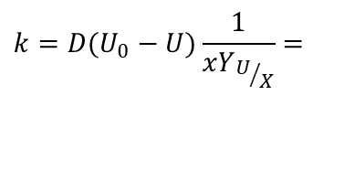
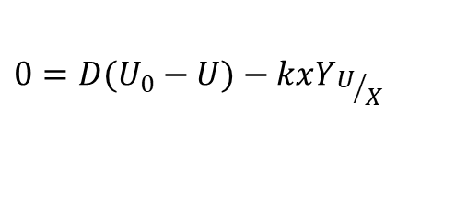
MeOH: 5 g L⁻¹
Uranium in: 0.01 g L⁻¹
Uranium out: 0.5 mg L⁻¹
Y_{X/MeOH}: 0.6 g g⁻¹
Ks: 0.1 g L⁻¹
μ_{max}: 0.345 h⁻¹
s < 0.05 g L⁻¹
R = -kx
Y_{U/X}: 0.5 mg g⁻¹
D = 0.115 h⁻¹
x = 2.97 g L⁻¹
With the biomass of 2.97 g L⁻¹ about 1.485 mg of uranium could be removed. However, this is valid when there is infinite reaction time available.
a) k under steady-state conditions:
$$0=D(U_{0}−U)−kxY_{U/X}$$
$$k=D(U_{0}−U)\frac{1}{xY_{U/X}}=$$
0.736 h⁻¹
b) Assumption that k is only 0.368 h⁻¹:
$$0=D(U_{0}−U)−kxY_{U/X}$$
x = 5.94 g L⁻¹

Slide 5
Task 13: Substrate conversion and biomass productivity in a chemostat
A 5 m³ fermenter is operated continuously with a feed substrate concentration of 20 kg m⁻³. The genetically engineered microorganism cultivated in the reactor has the following characteristics:
μ_{max} = 0.45 h⁻¹; K_{s} = 800 g m⁻³; Y_{X/S} = 0.55 kg kg⁻¹
What feed flow rate is required to achieve 90% substrate conversion?
How does the biomass productivity at 90% substrate conversion
compare with the maximum possible?
What is the biomass concentration in case a and at the optimal dilution rate?
D = 0.321 h⁻¹, F = 1.61 m³ h⁻¹
D is higher: Dm = 0.362 h⁻¹
In case of D = 0.321 h⁻¹ x = 9.91 g L⁻¹
and for D = 0.362 h⁻¹ x = 9.19 g L⁻¹

Slide 6
Task 14: Substrate conversion and biomass productivity in a chemostat
The specific growth rate for inhibited growth in a chemostat is given
by the following equation:
µ = µ_{max} s /(K_{s} + s + I K_{s} / K_{i} )
Where
s₀ = 10 g L⁻¹, K_{s} = 1 g L⁻¹; I = 0.05 g L⁻¹, Y_{xs} = 0.1 g g⁻¹
x₀ = 0 g L⁻¹, K_{i} = 0.01 g L⁻¹, µ_{max} = 0.5 h⁻¹
a) Determine X and S as function of D when I = 0
b) With inhibitor added to a chemostat, determine the effluent
substrate concentration and x as function of D
c) Determine the cell productivity, Dx, as a function of dilution rate
s=DKs/(μ_{max}-D)
x=Y_{X/S}(s₀-s)
x=Y_{X/S}(s₀-DKs/(μ_{max}-D))
b) s=D(Ks+(I*Ks/Ki)/(μ_{max}-D)
x=Y_{X/S}(s₀-(D(Ks+(I*Ks/Ki))/(μ_{max}-D)
c) P_{x}=D(Y_{X/S}(s₀-(D(Ks+(I*Ks/Ki))/(μ_{max}-D)

Slide 7
Task 15: Pirt Equation & Lineweaver-Burk Plot
A new strain of yeast is being considered for biomass production. The following data were obtained using a chemostat. An influent substrate concentration of 800 mg/l and an excess of oxygen were used at a pH of 5.5 and T = 35°C. Using following data, calculate µ_{max}, K_{s}, Y_{X/S}, k_{d} and m_{s}, assuming µ = µ_{max} S / (K_{S} + S) - k_{d}
D [h⁻¹] | C-source Concentration in steady-state [mg L⁻¹] | Cell concentration [mg/l]
0.1 0.2 0.3 0.4 0.5 0.6 0.7 | 16.7 33.5 59.4 101 169 298 702 | 366 407 408 404 371 299 59

Slide 8
Lineweaver-Burk Plot
1/μ
K_{S}/μ_{m}
1/μ_{m}
1/S
-1/K_{S}
µ_{max}, K_{s}, Y_{X/S}, k_{d} and m_{s}, assuming µ = µ_{max} S / (K_{S} + S) - k_{d}

Slide 9
1/μ_{max} = 1.0637 h
μ_{max} = 0.94 h⁻¹
Ks=0.137 g L⁻¹

